Slide 1

HTTP Protocol​
Handling Requests, ​ Constructing Responses, HTTP/2
SoftUni Team
Technical Trainers
Software University
http://softuni.bg

Slide 2
Table of Contents
Http Basics
URL
Http Request
Http Response
MIME and Media types
Web Server
Html Forms
<number>

Slide 3
Questions?
sli.do
#Java-Web
<number>

Slide 4

HTTP Basics​
Request and Responses

Slide 5


Hyper Text Transfer Protocol
Request
Response
HTTP
HTTP
TCP
TCP
IP
IP
Ethernet
Media (wires / air / fiber)
Ethernet
<number>
Notes:
HTTP == Hyper Text Transfer Protocol
Client-server protocol for transferring Web resources (HTML files, images, styles, scripts, data, etc.)
The widespread protocol for Internet communication today
Request-response model (client requests, server answers)
Text-based format (human readable)
Relies on unique resource URLs
Provides resource metadata (e.g. encoding)
Stateless (cookies and Web storages can overcome this)
© Software University Foundation – http://softuni.org
This work is licensed under the Creative Commons Attribution-NonCommercial-ShareAlike license.
<number>

Slide 6
HTTP Request Methods
HTTP defines methods to indicate the desired action to be
performed on the identified resource
Method | Description
GET | Retrieve / load a resource
POST | Create / store a resource
PUT | Update a resource
DELETE | Remove a resource
<number>

Slide 7
HTTP Conversation: Example
GET /courses/javascript HTTP/1.1
Host: www.softuni.bg
User-Agent: Mozilla/5.0
<CRLF>
HTTP request:
HTTP response:
The empty line denotes the end of the request header
HTTP/1.1 200 OK
Date: Mon, 5 Jul 2010 13:09:03 GMT
Server: Microsoft-HTTPAPI/2.0
Last-Modified: Mon, 12 Jul 2014 15:33:23 GMT
Content-Length: 54
<CRLF>
<html><title>Hello</title>
Welcome to our site</html>
The empty line denotes the end of the response header
<number>

Slide 8

URL
Uniform Resource Locator

Slide 9
Uniform Resource Locator (URL)
http://mysite.com:8080/demo/index.php?id=27&lang=en#lectures
Protocol
Host
Port
Path
Query String
Fragment
URL is a formatted string, consisting of:
Protocol for communicating (http, ftp, https...) – HTTP in most cases
Host or IP address (www.softuni.bg, gmail.com, 127.0.0.1, web)
Port (the default port is 80) – a number in range [0…65535]
Path (/forum, /path/index.php)
Query string (?id=27&lang=en)
Fragment (#lectures) – used on the client to navigate to some section
<number>

Slide 10
URL Encoding
URLs are encoded according RFC 1738:
Safe URL characters: [0-9a-zA-Z], $, -, _, . , +, *, ', (, ), ,, !
All other characters are escaped by:
Space is encoded as "+" or "%20"
Example:
URL-encoded string:
Char | URL Encoding
space | %20
щ | %D1%89
" | %22
# | %23
$ | %24
% | %25
& | %26
%[character hex code]
Наков-爱-SoftUni
%D0%9D%D0%B0%D0%BA%D0%BE%D0%B2-%E7%88%B1-SoftUni
<number>

Slide 11
Valid and Invalid URLs – Examples
Some valid URLs:
Some invalid URLs:
http://www.google.bg/search?sourceid=navclient&ie=UTF-8&rlz=1T4GGLL_enBG369BG369&q=http+get+vs+post
http://bg.wikipedia.org/wiki/%D0%A1%D0%BE%D1%84%D1%82%D1%83%D0%B5%D1%80%D0%BD%D0%B0_%D0%B0%D0%BA%D0%B0%D0%B4%D0%B5%D0%BC%D0%B8%D1%8F
Should be: ?q=C%23+.NET+4.0
http://www.google.bg/search?&q=C# .NET 4.0
Should be: ?q=%D0%B1 %D0%B8%D1%80%D0%B0
http://www.google.bg/search?&q=бира
<number>

Slide 12

HTTP Request​
What is a HTTP Request?

Slide 13
HTTP Request Message
Request message sent by a client consists of:
HTTP request line
Request method (GET / POST / PUT / DELETE / …)
Resource URI (URL)
Protocol version
HTTP request headers
Additional parameters
HTTP request body – optional data, e.g. posted form fields
<method> <resource> HTTP/<version>
<headers>
(empty line)
<body>
<number>

Slide 14
HTTP GET Request – Example
Example of HTTP GET request:
GET /index.html HTTP/1.1
Host: localhost
<CRLF>
HTTP request headers
HTTP request line
The request body is empty
<number>
Notes:
© Software University Foundation – http://softuni.org
This work is licensed under the Creative Commons Attribution-NonCommercial-ShareAlike license.
<number>

Slide 15
HTTP POST Request – Example
Example of HTTP POST request:
POST /login.html HTTP/1.1
Host: localhost
Content-Length: 59
<CRLF>
username=mente&password=top*secret!
<CRLF>
HTTP request line
HTTP request headers
The request body holds the submitted form data
<number>

Slide 16

HTTP Response​
What is a HTTP Response?

Slide 17
HTTP Response Message
The response message sent by the HTTP server consists of:
HTTP response status line
Protocol version
Status code
Status phrase
Response headers
Provide meta data about the returned resource
Response body
The content of the HTTP response (data)
HTTP/<version> <status code> <status text>
<headers>
(empty line)
<response body – the requested resource>
<number>

Slide 18
HTTP Response – Example
Example of HTTP response from the Web server:
HTTP response status line
HTTP/1.1 200 OK
Date: Fri, 17 Jul 2010 16:09:18 GMT+2
Server: Apache/2.2.14 (Linux)
Accept-Ranges: bytes
Content-Length: 84
Content-Type: text/html
<CRLF>
<html>
<head><title>Test</title></head>
<body>Test HTML page.</body>
</html>
HTTP response headers
HTTP response body
<number>

Slide 19
HTTP Response Codes
HTTP response code classes
1xx: informational (e.g., "100 Continue")
2xx: successful (e.g., "200 OK", "201 Created")
3xx: redirection (e.g., "304 Not Modified", "301 Moved Permanently", "302 Found")
4xx: client error (e.g., "400 Bad Request", "404 Not Found", "401 Unauthorized", "409 Conflict")
5xx: server error (e.g., "500 Internal Server Error", "503 Service Unavailable")
<number>

Slide 20
HTTP Response – Example
Example of HTTP response with error result:
HTTP response status line
HTTP/1.1 404 Not Found
Date: Fri, 17 Nov 2014 16:09:18 GMT+2
Server: Apache/2.2.14 (Linux)
Connection: close
Content-Type: text/html
<CRLF>
<html><head><title>404 Not Found</title></head>
<body>
<h1>Not Found</h1>
<p>The requested URL /img/logo.gif was not found on this server.</p> <hr><address>Apache/2.2.14 Server at Port 80</address>
</body></html>
HTTP response headers
The HTTP response body
<number>

Slide 21
Browser Redirection
HTTP GET requesting a moved URL:
The following HTTP response (301 Moved Permanently) tells
the browser to request another URL:
GET / HTTP/1.1
Host: http://softuni.org
User-Agent: Gecko/20100115 Firefox/3.6
<CRLF>
HTTP/1.1 301 Moved Permanently
Location: http://softuni.bg
…
<number>

Slide 22
Content-Type and Disposition
The Content-Type response header the server specifies how the output should be processed
Examples:
UTF-8 encoded HTML page. Will be shown in the browser.
Content-Type: text/html; charset=utf-8
Content-Type: application/pdf
Content-Disposition: attachment; filename="Report-April-2016.pdf"
This will download a PDF file named Report-April-2016.pdf
<number>

Slide 23

MIME and Media Types
Multi-Purpose Internet Mail Extensions

Slide 24
What is MIME?
MIME == Multi-Purpose Internet Mail Extensions
Internet standard for encoding resources
Originally developed for email attachments
Used in many Internet protocols like HTTP and SMTP
MIME defines several concepts
Content-Type, e.g. text/html, image/gif, application/pdf
Content charset, e.g. utf-8, ascii, windows-1251
Content-Disposition, e.g. attachment; filename=logo.jpg
Multipart messages (multiple resources in a single document)
<number>

Slide 25
Common MIME Media Types
MIME Type / Subtype | Description
application/json | JSON data
image/png | PNG image
image/gif | GIF image
text/html | HTML
text/plain | Text
text/xml | XML
video/mp4 | MP4 video
application/pdf | PDF document
<number>

Slide 26

HTTP
Tools for Developers

Slide 27
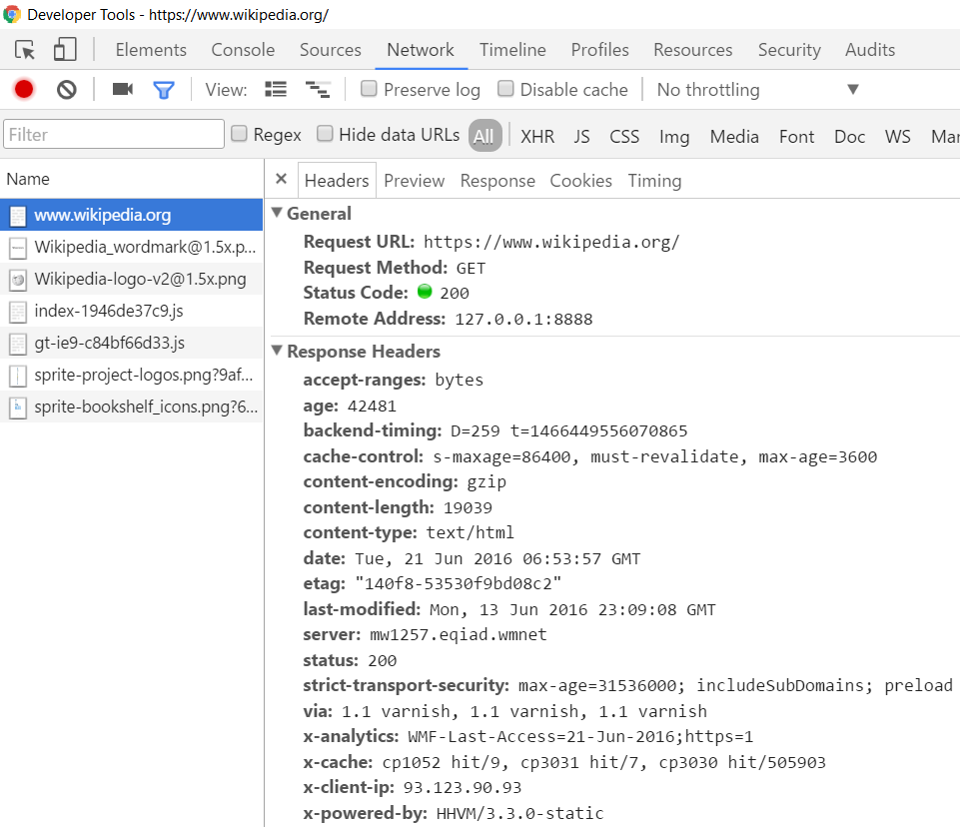
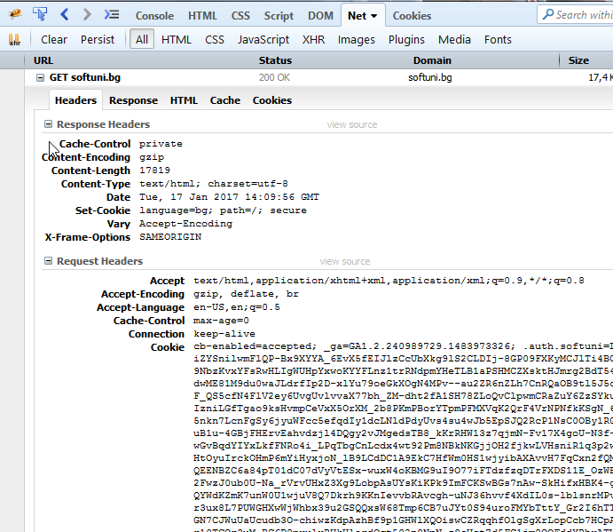
HTTP Tools for Developers - Browser
Chrome Developer Tools
Firebug
<number>

Slide 28


HTTP Tools for Developers - Browser (2)
Postman - Chrome
RESTClient - Firefox
<number>

Slide 29
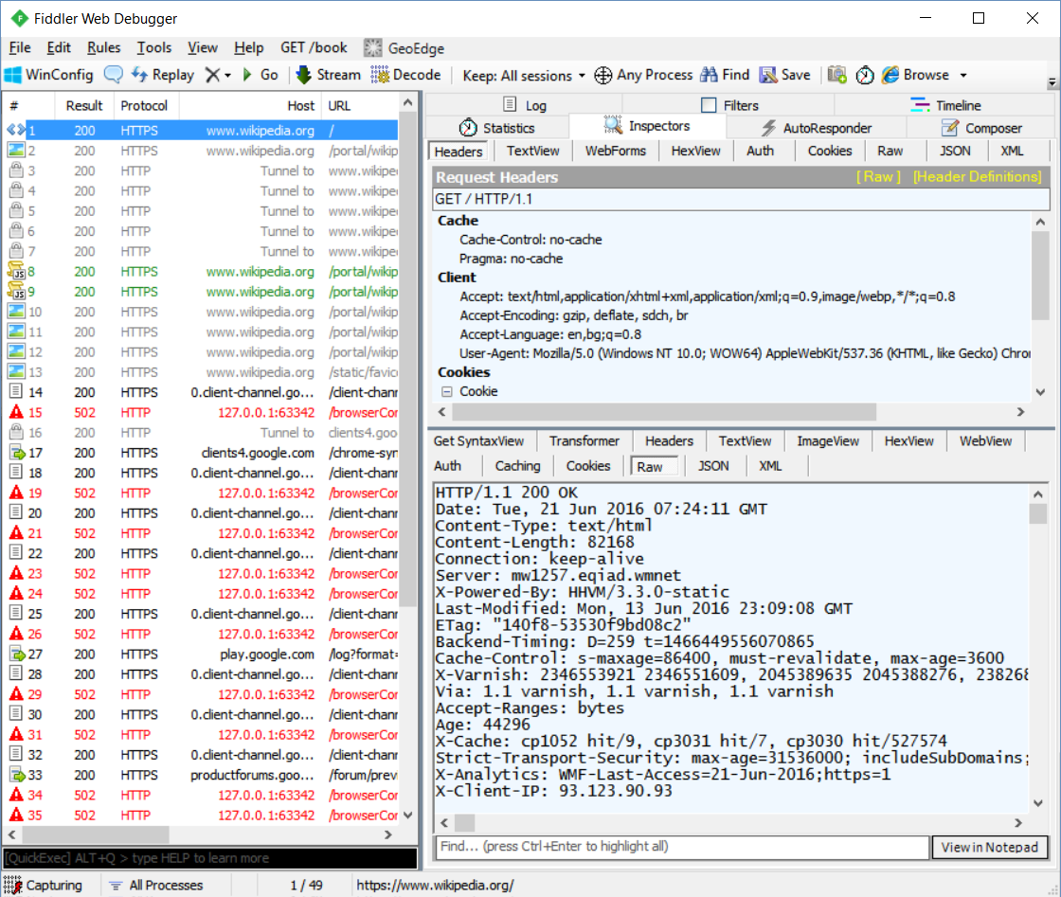
HTTP Tools for Developers - Desktop
Fiddler
<number>

Slide 30



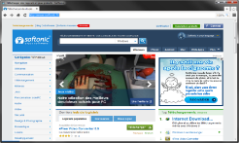
Web Server

Slide 31

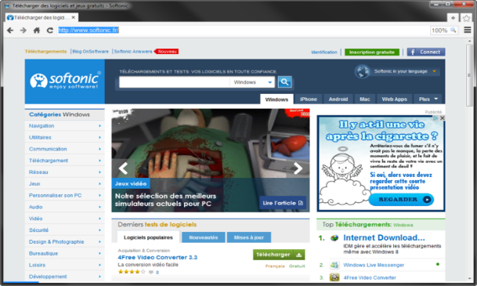



What is a Web Server?
Computer system that processes requests via HTTP, the basic network protocol
Web Client
Web Server
Communication
<number>

Slide 32

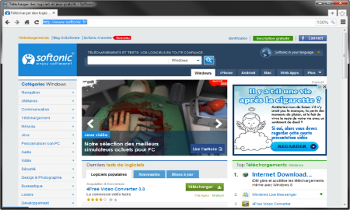
Web Server Work Model
Web Server
Web Resources
Web Client
Request
Protocol
Response
HTML, PDF, JPG…
Protocols:
HTTP FTP WebSocket
Protocol
Host
Port
Resource
URL
http://localhost:8000/softuni.jpg
<number>

Slide 33



Web Server Work Model (2)
Web Server
Technology
Web Client
Request
Protocol
Response
Web Resources
Database
HTML, PDF, JPG…
<number>

Slide 34


Web Server Work Model (3)
Web Server
Technology
Spring
Web Resources
Database
HTML, PDF, JPG…
<number>

Slide 35
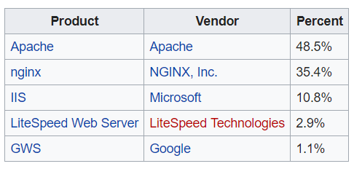

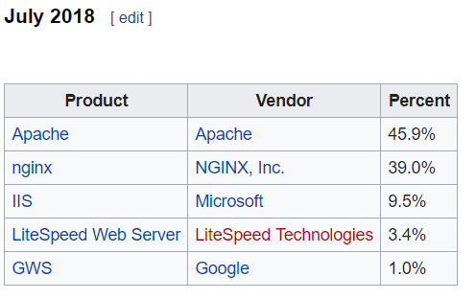

Most Popular Web Servers (W3Techs)
<number>

Slide 36
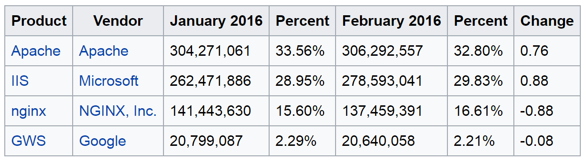
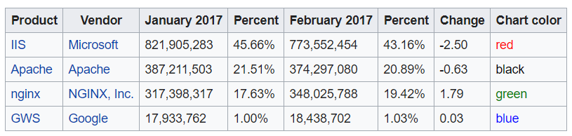
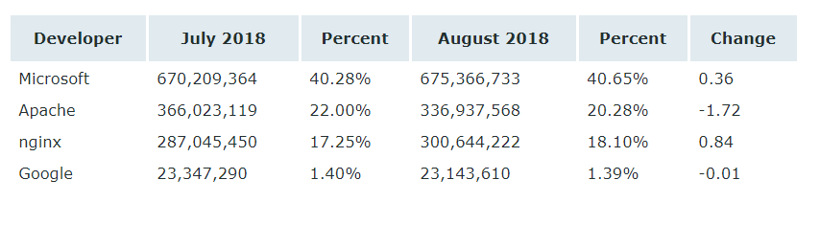
Most Popular Web Servers (NetCraft)
<number>

Slide 37



HTML Forms
Form Method and Action

Slide 38


HTML Forms - Action Attribute
Defines where to submit the form data:
<form action="home.html">
<input type="submit" value="Go to homepage"/>
</form>
<number>

Slide 39
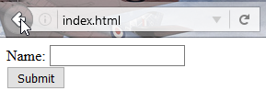
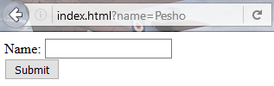
HTML Forms – Method Attribute
Specifies the HTTP method to use when sending form-data
<form method="get"> Name: <input type="text" name="name"> <br>
<input type="submit" value="Submit">
</form>
The form data is in the URL
<number>

Slide 40
HTML Forms – Method Attribute (2)
<form method="post"> Name: <input type="text" name="name"> <br>
<input type="submit" value="Submit">
</form>
POST http://localhost/index.html HTTP/1.1
Host: localhost
Content-Type: application/x-www-form-urlencoded
Content-Length: 10
name=Pesho
HTTP request body holds the form data
<number>

Slide 41
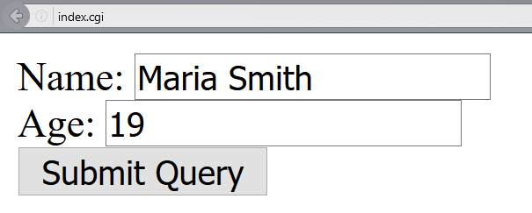
URL Encoded Form Data – Example
<form method="post">
Name: <input type="text" name="name"/> <br/>
Age: <input type="text" name="age"/> <br/>
<input type="submit" />
</form>
POST http://localhost/cgi-bin/index.cgi HTTP/1.1
Host: localhost
Content-Type: application/x-www-form-urlencoded
Content-Length: 23
name=Maria+Smith&age=19
File uploads are not supported
<number>

Slide 42

HTTP/2
What’s new? What’s better? What’s HTTP/2

Slide 43

What’s HTTP/2
HTTP/2 (originally named HTTP/2.0) major revision of the HTTP network protocol used by the World Wide Web.
Supported by most of the popular web browsers (Chrome, Mozilla, Opera...)
Fast & Optimized. Meets modern web usage requirements.
Completely Backwards-Compatible.
As of January 2019, 32.5% of the top 10 million websites support HTTP/2 (W3Techs statistics).
<number>

Slide 44

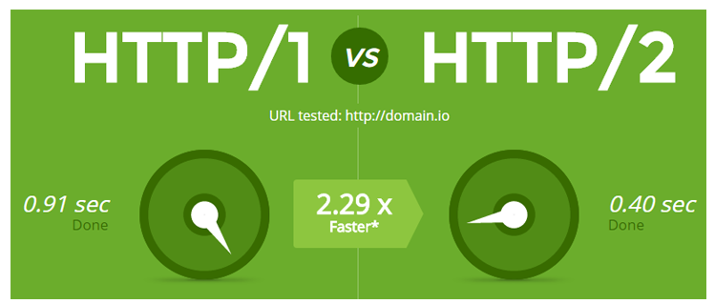
What’s new?
HTTP/2 is meant to erase the need of maintaining complex server infrastructures in order to perform well.
HTTP/2 communicates in binary data frames.
HTTP/2 introduces several new important elements:
HTTP/2 Multiplexing
HTTP/2 Header Compression
HTTP/2 Server Push
<number>

Slide 45
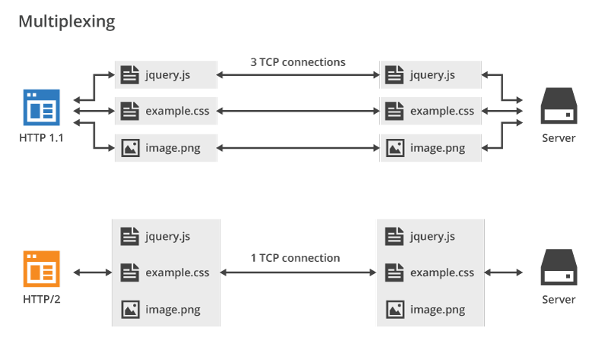
HTTP/2 Multiplexing
The art of handling multiple streams over a single TCP connection.
<number>

Slide 46
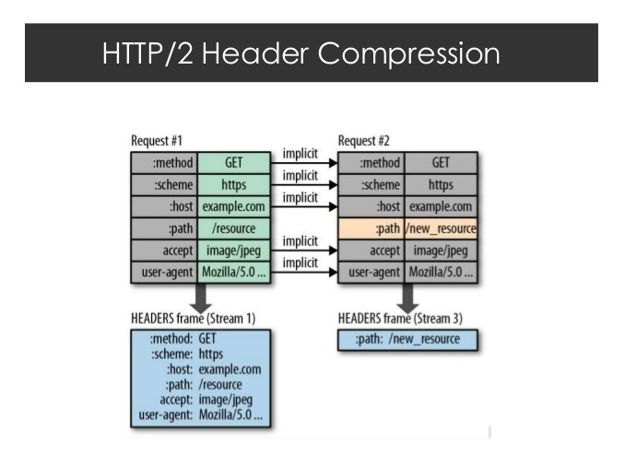
HTTP/2 Header Compression
HTTP/2 maintains a HTTP Header Table across requests.
Optimizes communication drastically.
The process is essentially a de-duplication, rather than compression.
<number>

Slide 47
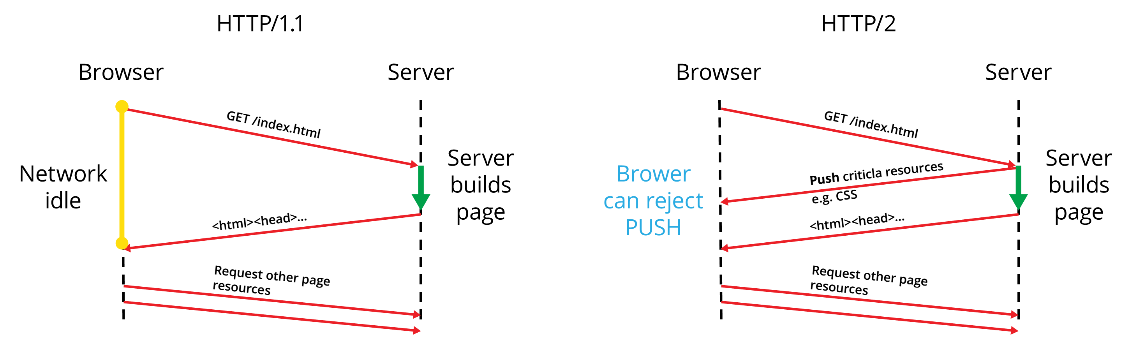
HTTP/2 Server Push
HTTP/2 Server Push is the process of sending resources to clients, without them having to ask for it.
<number>

Slide 48




Summary
What is HTTP?
HTML Forms & Actions.
URLs.
What is a Web Server?
Beneath the sheets of Web Communication.
How to handle HTTP Requests?
How to construct HTTP Responses?
<number>

Slide 49
https://softuni.bg/trainings/courses
Notes:
© Software University Foundation – http://softuni.org
This work is licensed under the Creative Commons Attribution-NonCommercial-ShareAlike license.
<number>

Slide 50












SoftUni Diamond Partners

Slide 51




SoftUni Organizational Partners

Slide 52




Trainings @ Software University (SoftUni)
Software University – High-Quality Education and Employment Opportunities
softuni.bg
Software University Foundation
http://softuni.foundation/
Software University @ Facebook
facebook.com/SoftwareUniversity
Software University Forums
forum.softuni.bg
Notes:
© Software University Foundation – http://softuni.org
This work is licensed under the Creative Commons Attribution-NonCommercial-ShareAlike license.
<number>

Slide 53

License
This course (slides, examples, demos, videos, homework, etc.) is licensed under the "Creative Commons Attribution-NonCommercial-ShareAlike 4.0 International" license
<number>
Notes:
© Software University Foundation – http://softuni.org
This work is licensed under the Creative Commons Attribution-NonCommercial-ShareAlike license.
<number>

